Slide 1
Margin Protection Program for Dairy Producers: How the Program Works and Highlights of the Operating Rules
Andrew Novakovic
The E.V. Baker Professor of Agricultural Economics
Cornell University

Slide 2
Who is the National Program on Dairy Markets and Policy A voluntary association of Land Grant agricultural economists who share an interest in the economics of dairy markets and policy and who are committed to provide educational and research materials to assist policy-makers and dairy industry decision-makers.
Marin Bozic
University of Minnesota
Brian Gould
University of Wisconsin
John Newton
University of Illinois
Charles Nicholson
The Pennsylvania State University
Andrew Novakovic
Cornell University
Mark Stephenson
University of Wisconsin
Cameron Thraen
The Ohio State University
Christopher Wolf
Michigan State University

Slide 3
What is the MPP-Dairy Producer Decision Education Project?
Funded by USDA Farm Service Agency, as authorized by the Agricultural Act of 2014.
For the purpose of developing a decision tool for dairy farmers and complementary educational programs.
Conducted under a university consortium led by the University of Illinois and referred to as the National Coalition for Producer Education.
Our goal is to help producers make an informed decision consistent with their goals, strategies and needs.

Slide 4
Presentation Outline (What but also Why and Now What)
Why do we have MPP-Dairy?
What dairy farm challenges does MPP-Dairy address?
What does MPP-Dairy do?
What are my choices?
What comes next?

Slide 5
Why do we have MPP-Dairy? The time was ripe for change
Economic conditions in late 2000s overwhelmed existing programs
Political conditions were aligned for change
Old DPSP/DPPSP had become “radioactive”
MILC was inadequate and unpopular with mid-sized to larger farms
New farm bill created a legislative opportunity
Insurance programs favored over direct payments
A plan that supported dairy farm incomes when milk prices were low relative to feed costs
Seemed to address current needs
Was not really opposed by anyone, although it wasn’t everyone’s first choice
Was positioned to be consistent with crop insurance models that emerged as the preferred policy platform in the last farm bill discussion
DPPSP, MILC and DEIP were eliminated to get a budget offset. DPSP permanent law remains, but it is more of a threat than an actual Plan B.

Slide 6
Aren’t There Other Financial Risk Management Tools for Dairy Farmers?
Absolutely!
Public Tools: LGM-Dairy and now MPP-Dairy (pick one)
Private Sector Tools (things a farmer can do on his own):
Hedging milk (Class III & IV), corn, SBM
Options: PUT milk to floor milk price, CALL to cap corn and SBM prices
Forward contracting feed
Advance purchase of feed
Collective Solutions (things farmers do with help):
Forward pricing: cooperative or other buyer offers a fixed price contract for a future period and uses futures markets to protect their position.

Slide 7
Why Do We Need Another Tool?
3 key characteristics of Volatility
Certainty (I know the future price)
Adequacy (I can get by with the future price)
Stability (future prices bounce around faster than I can handle)
Futures contracts are great for Certainty but no guarantee of adequacy (and don’t change market stability)
Countercyclical payments help with Adequacy
Price supports could lead to greater Stability but the cost is prohibitive
MPP-Dairy operates primarily to help with Adequacy

Slide 8
The Basic Design of MPP-Dairy Key Questions, Key Characteristics
Am I eligible?
What is my Production History?
How much of my PH do I want to “cover” under this program – Covered Production History?
What is the national Actual Dairy Producer Margin?
How low can the ADPH go before I want to get a benefit payment? How much am I willing to pay to get a benefit payment?
I pay USDA the premium (for sure). USDA pays me a benefit (if it is triggered).
Repeat annually through 2018.

Slide 9
The Basic Design of MPP-Dairy Registration Period (enrollment, sign-up)
Producers establish their production history once, unless there is some change in status. [CCC-781]
Producers “register” – select coverage levels – annually, corresponding to the calendar years in which program benefits apply [CCC-782]
2014: 2 September to 28 November 2014
2015: 2 September to 28 November 2014
2016: 1 July to 30 September 2015
2017: 1 July to 30 September 2016
2018: 3 July to 2 October 2017
YOU DON’T HAVE TO ENROLL NOW (but if you don’t register in 2015 you will forego the first “bump”)

Slide 10
The Basic Design of MPP-Dairy Eligibility (must be, must have)
Have Current commercial marketings, in U.S. or its territories (on-farm sales of milk must be documented, farmstead manufacturing must be documented and will be equated to milk marketings using USDA conversion factors)
Be U.S. citizen or legal resident alien
Be "actively engaged" in the dairy farm business, directly or indirectly share in the risk of producing milk, and make contributions including land, labor, management, equipment or capital to the dairy operation commensurate with their share of the business.
Certify conservation compliance (HELC/WC)
Do not have active LGM-Dairy contract during program year (2014/15 completion allowed)

Slide 11
The Basic Design of MPP-Dairy Eligibility – Ownership Structures
Previous MILC participants retain the identify of their farm operation as established under MILC
Non-participants in MILC start fresh
May have any form of business ownership.
One operation may have multiple owners. Partners or shareholders must disclose their identity.
One owner(s) may have more than one operation.
Changes in ownership (who or what) have implications for participation. (merging or using old PH, establishing new PH)
US or permanent resident. Foreign shares are subtracted from total benefits

Slide 12
The Basic Design of MPP-Dairy Establishing Production History (CCC-781)
You have current marketings
Your first marketings are before 8 Feb 2013 – you are an existing operation
Highest annual marketings in 2011, 2012, or 2013
Your first marketings are after 1 Jan 2013 but before 8 Feb 2013 =>
you are an existing operation and
will have the 10 or 11 full months marketings of 2013 for your PH

Slide 13
The Basic Design of MPP-Dairy Establishing Production History (CCC-781)
You have current marketings
Your first marketings are on 8 Feb 2013 or later, you are a new operation and get to extrapolate your full month actuals to a 12-month value, based on either
Option I - A national monthly milk production index or
Option II - A national annual yield factor times your number of milk cows (21,822 lbs/yr – 2013 US yield - for 2014 & 2015, adjusted thereafter)
Seasonal producers extrapolate based on stated number of months of marketings
Your actual seasonality or yield does not factor into the extrapolation

Slide 14
The Basic Design of MPP-Dairy Establishing Production History (CCC-781)
In future years:
Your Production History is subject to an annual increase based on national increase in production
Announced by Secretary
Can only go up
2015 “bump” is 1.0087 or + 0.87%
Must be registered in the program to be eligible
Producers who delay registration after 2015 program year will miss previous bumps when they do register
New operations establish base in the same manner as 2014 (extrapolating from first full month of marketings)
Option II yield factor is also subject to annual adjustment

Slide 15
The Basic Design of MPP-Dairy Benefits Based on ADPM (Margin)
A new Actual Dairy Producer Margin (margin) will be calculated monthly and averaged for fixed 2-month pairs: Jan/Feb, Mar/Apr, May/Jun…..
ADPM is a type of Income Over Feed Cost, based on
US average All Milk Price estimate (NASS)
US average (grain) Corn Price estimate (NASS)
US average Alfalfa Hay Price estimate (NASS)
Decatur-Central Illinois reported price for Soybean Meal delivered by rail, calculated as simple average of reported high and low (AMS-Market News)
Original formula developed based on a ration of corn grain, corn silage, SBM and hay for a typical dairy herd (milk cows, young stock, etc.).
Milk $/cwt –
[1.0728 X Corn $/bu] + [0.00735 X SBM $/ton] + [0.0137 X Alfalfa $/ton]
= ADPM $/cwt of milk

Slide 16
Margin Calculations for 2014
Period | ALL MILK | CORN | CORN SILAGE Value | SBM | ALFALFA HAY | FEED Cost | MILK- FEED Margin
 | $/cwt. | $/bu. | $/ton | $/ton | $/ton | $/cwt. | $/cwt.
2014.01 | $23.50 | $4.42 | $44.64 | $479.54 | $185.00 | $10.71 | $12.79
2014.02 | $24.90 | $4.35 | $43.94 | $409.25 | $188.00 | $10.73 | $14.17
Jan/Feb |  |  |  |  |  |  | $13.31
2014.03 | $25.20 | $4.51 | $45.55 | $497.82 | $191.00 | $11.10 | $14.10
2014.04 | $25.30 | $4.71 | $47.57 | $514.01 | $206.00 | $11.63 | $13.67
Mar/Apr |  |  |  |  |  |  | $13.87
2014.05 | $24.20 | $4.71 | $47.57 | $519.38 | $224.00 | $11.93 | $12.27
2014.06 | $23.30 | $4.37 | $44.14 | $501.79 | $222.00 | $11.69 | $11.61
May/Jun |  |  |  |  |  |  | $12.07

Slide 17
The Basic Design of MPP-Dairy Benefit Payments
If the US average bi-monthly ADPM falls below the coverage level you select, you get the $/cwt difference on 1/6 of the annual quantity of milk you have chosen to cover
Paid in the following month.
Period. The end.
Example of time flow.
September buying and selling of milk, corn, SBM and alfalfa occurs
USDA AMS publishes SBM price in middle of October.
USDA NASS releases final estimates All Milk, Corn and Alfalfa prices around end of October.
October happens, USDA reports same prices in mid and late November
Sep/Oct ADPM is announce late November
Any benefit payments that are triggered are paid in December.
N.b., if you have any outstanding premium due, it will be taken off the top. If you are in arrears, you won’t receive a benefit.

Slide 18
The Basic Design of MPP-Dairy Registration or Coverage Election (CCC-782)
Producers choose
Coverage Level Threshold - $4 to $8 in 50¢ increments
Coverage Level Percentage – 25% to 90% of production history = covered production history
All partners/shareholders must agree on coverage
One coverage level on all eligible milk
Change annually (within year termination allowed only in case of death, retirement, or dissolution)
New Operations can begin in the year they start operation if they register within 90 days
CAT coverage is default ($4 on 90%)

Slide 19
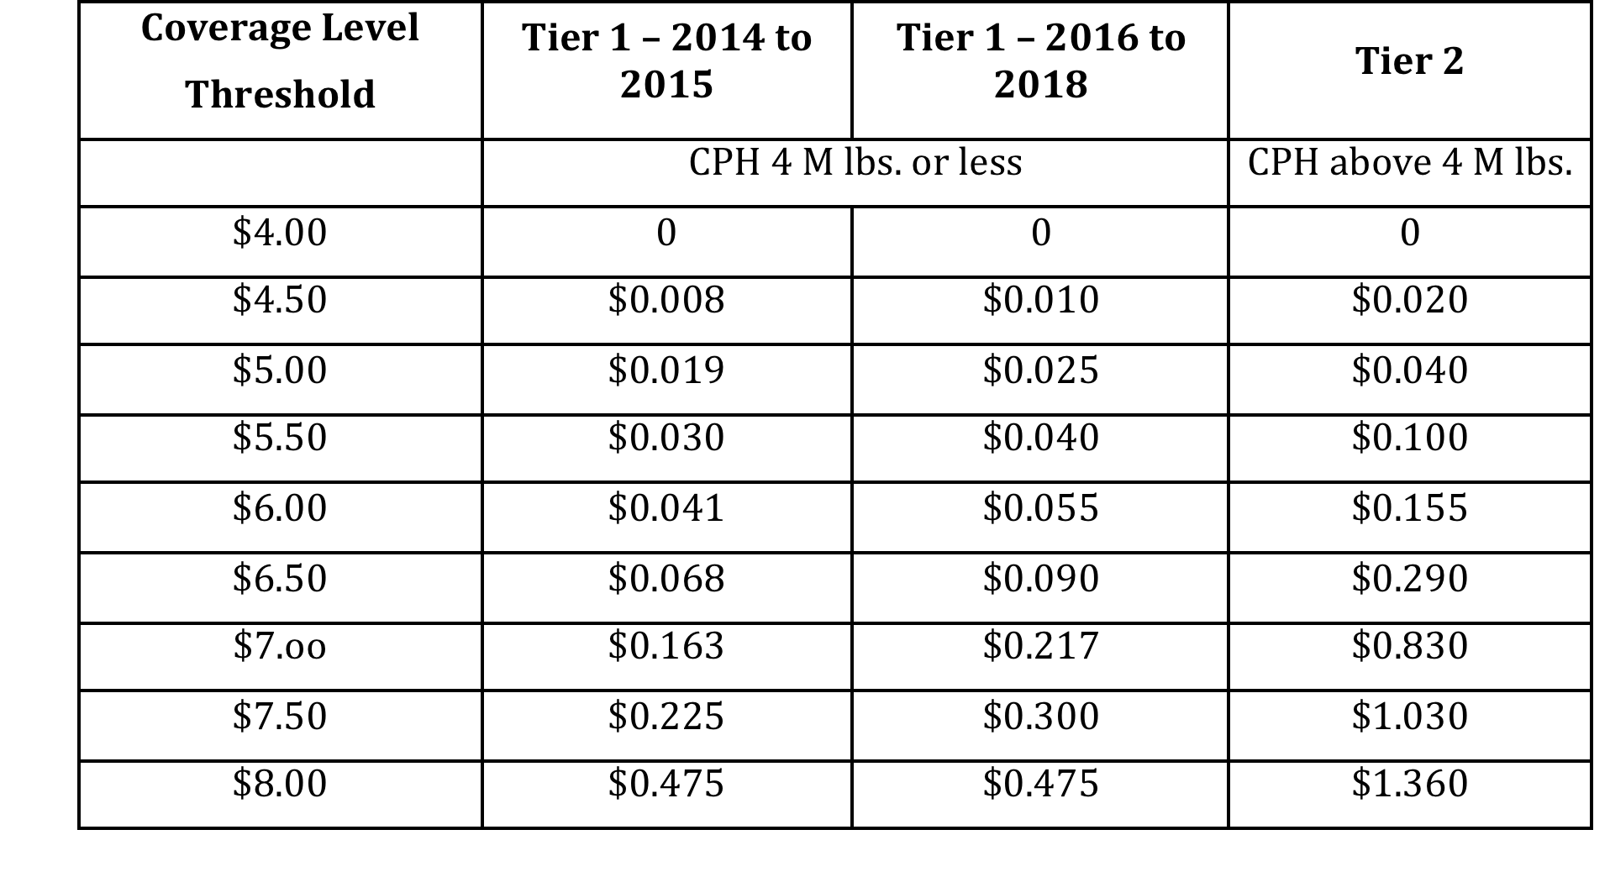
Premia for MPP-Dairy, exclusive of $100 Administrative Fee (dollars per cwt.)

Slide 20
Premia for MPP-Dairy

Slide 21
Historical Examples of Payment Thresholds

Slide 22
What if something changes after my first registration?
If you are thinking about a change in ownership – selling, buying or restructuring
Talk to FSA before to get the scoop
File a new CCC-781
Retention of PH hinges on whether seller continues farming. Can merge two operation’s PH when buying.
“Affiliation Rule” will determine if a new operation is new for the program or an extension of existing operation (key is majority share in more than one operation)
Retirement, death or dissolution are only reasons for terminating registration (must notify)

Slide 23
Program Design and Farmer Strategies
MPP parameters are representative of a hypothetical US farm, not your farm
How do these parameters relate to your farm IOFC?
Does it matter?
Insurance programs and hedging are about managing risk (although many dairy farmers talk about them as if they were placing a bet)
Do you hope you never get an indemnity payment, or
Are you disappointed if you don’t get one?
Countercyclical payment programs are a “safety net”. They aren’t “insurance” in the formal sense. Nothing to lose by signing up.
MPP-Dairy has characteristics of both a countercyclical payment and an insurance program: Buy-up at a price, but premiums do not vary with market risk.

Slide 24
Program Design and Farmer Strategies
HOW WILL FARMERS APPROACH THE ENROLLMENT DECISION?
What is my goal/strategy?
Is my goal to manage my farm risk - a precaution, or
Is it to maximize my expected payment given a premium – a bet?
What is my management capacity or perspective?
Sincere? (keep it simple)
Sophisticated? (tell me the rules, show me your tool)
Cynical? (I don’t care)

Slide 25
The Next Presentations
How can we estimate or think about near term price expectations? What am I likely to face in the coming year?
How does the DMaP decision tool for MPP-Dairy work and how can farmers use it to help them think through their participation decision
What are my premium obligations and likely benefits under alternative Coverage Levels
What are some alternative strategies that different farms might consider
What if I had this tool before?
Alternative methods: How can I manage dairy farm risk – LGM-D for example?
Alternative Strategies: How can I evaluate my risk and risk tolerance

Slide 26
Margin Protection Program for Dairy Producers: How the Program Works and Highlights of the Operating Rules
Andrew Novakovic
The E.V. Baker Professor of Agricultural Economics
Cornell University

